Slide 1

FM based Wireless Public Announcement System
By: —ECE(core)
–Badmalatha. V(RA2211004010612) —I-section
–Ujjayati Saha (RA22110040106 —under the supervision of:
–K. Aparna (RA2211004010638) –Dr. Shayna Kumari

Slide 2
ABSTRACT
This project presents the design and implementation of an FM Wireless Public Announcement (PA) System that enables the wireless transmission of audio announcements over FM frequencies. This system offers a cost-effective, portable, and scalable solution suitable for schools, public gatherings, and emergency communications. The project highlights the integration of analog and digital components, ensuring clear transmission with minimal interference. Future enhancements may include multi-channel support, battery backup, and remote control via mobile apps.

Slide 3
INTRODUCTION
A Public Announcement (PA) system is widely used to convey messages to a large audience quickly and clearly.
Traditional PA systems rely on wired infrastructure, which can be costly, complex, and inflexible.
This project introduces a wireless FM-based PA system that uses Frequency Modulation (FM) to transmit audio signals without cables.
The proposed system is ideal for schools, colleges, public events, and emergency announcements, offering a cost-effective and portable alternative to conventional setups.

Slide 4
MOTIVATION AND OBJECTIVE
MOTIVATION:
Wired PA systems are often difficult to install and maintain, especially in large or outdoor environments.
There's a growing demand for flexible and portable solutions for public communication.
Using FM transmission allows long-range, clear audio delivery with minimal infrastructure.
The system reduces costs by eliminating the need for extensive wiring and fixed installations.
Inspired by real-world needs in educational institutions, public venues, and emergency response, this project aims to offer a simple, scalable, and reliable alternative.

Slide 5
OBJECTIVE:
To design and implement a wireless public announcement system using FM transmission.
To eliminate the need for wired infrastructure, increasing system portability and ease of deployment.
To ensure reliable audio communication over a practical distance with minimal interference.
To explore a cost-effective solution for announcements in schools, colleges, and public spaces.

Slide 6
LITERATURE REVIEW
YEAR | TITLE | AUTHORS | KEY TAKEAWAYS
2022 | Reconfigurable Intelligent Surface-aided M-ary FM-DCSK System: A New Design for Noncoherent Chaos-based Communication | Huan Ma, Yi Fang, Pingping Chen, Yonghui Li | Introduced a novel RIS-assisted FM-DCSK system that enhances noncoherent communication without requiring channel state information, offering low-cost and reliable wireless communication suitable for PA systems.
2023 | Wireless Smart Public Announcement System Using Bluetooth Technology | Khushi Banerjee, Sumanta Karmakar, Dr. Ashmi Chakraborty, Mausam Mihir Jha, Sanjana Ghosh, Anirban Bose | Developed a Bluetooth-based smart PA system enabling personalized and location-based announcements, demonstrating efficient dissemination of information in public spaces.
2024 | SONIC: Connect the Unconnected via FM Radio & SMS | Ayush Pandey, Rohail Asim, Khalid Mengal, Matteo Varvello, Yasir Zaki | Presented a system leveraging FM radio and SMS to disseminate web content, highlighting the potential of FM radio in reaching areas with limited internet connectivity, which can be adapted for PA systems.

Slide 7
PROBLEM STATEMENT
Traditional public announcement systems rely heavily on wired infrastructure, which can be expensive, difficult to install, and lacks flexibility.
In large campuses or temporary event setups, laying cables is impractical and time-consuming.
Existing wireless solutions often suffer from limited range, poor audio clarity, or high implementation costs.
There is a need for a cost-effective, reliable, and portable public announcement system that can broadcast messages wirelessly over a wide area using commonly available technology.

Slide 8
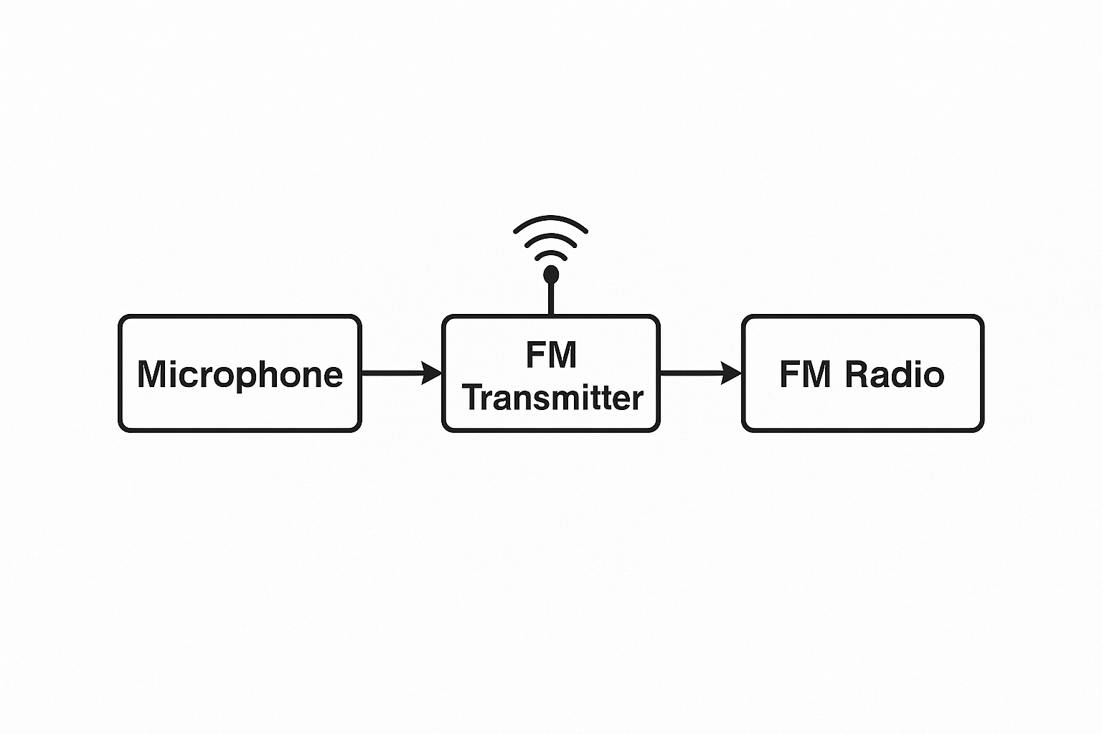
BLOCK DIAGRAM
Fig .1 .BLOCK DIAGRAM OF CIRCUIT

Slide 9
Block Explanation:
Microphone:
Captures the speaker’s voice (sound waves) and converts it into an electrical audio signal.
FM Transmitter:
Takes the electrical audio signal from the microphone, modulates it onto a high-frequency carrier wave, and transmits it wirelessly using an antenna.
FM Radio (Phone):
Acts as the receiver; it picks up the FM signal, demodulates it, and outputs the original audio through the phone’s speaker or connected headphones.

Slide 10
WORKING OF THE MODEL
The microphone captures the speaker’s voice and converts the sound into a weak electrical signal.
This weak signal is fed into the FM transmitter circuit, where it is modulated onto a carrier frequency (typically between 88 MHz to 108 MHz).
The FM transmitter broadcasts the modulated signal wirelessly through an antenna.
A nearby FM-enabled device (like a mobile phone with FM radio) tunes to the same frequency as the transmitter.
The mobile phone receives the FM signal, demodulates it, and reproduces the original sound through its speaker or headphones.
As a result, the voice message can be heard on any phone tuned to the specific FM frequency within range.

Slide 11
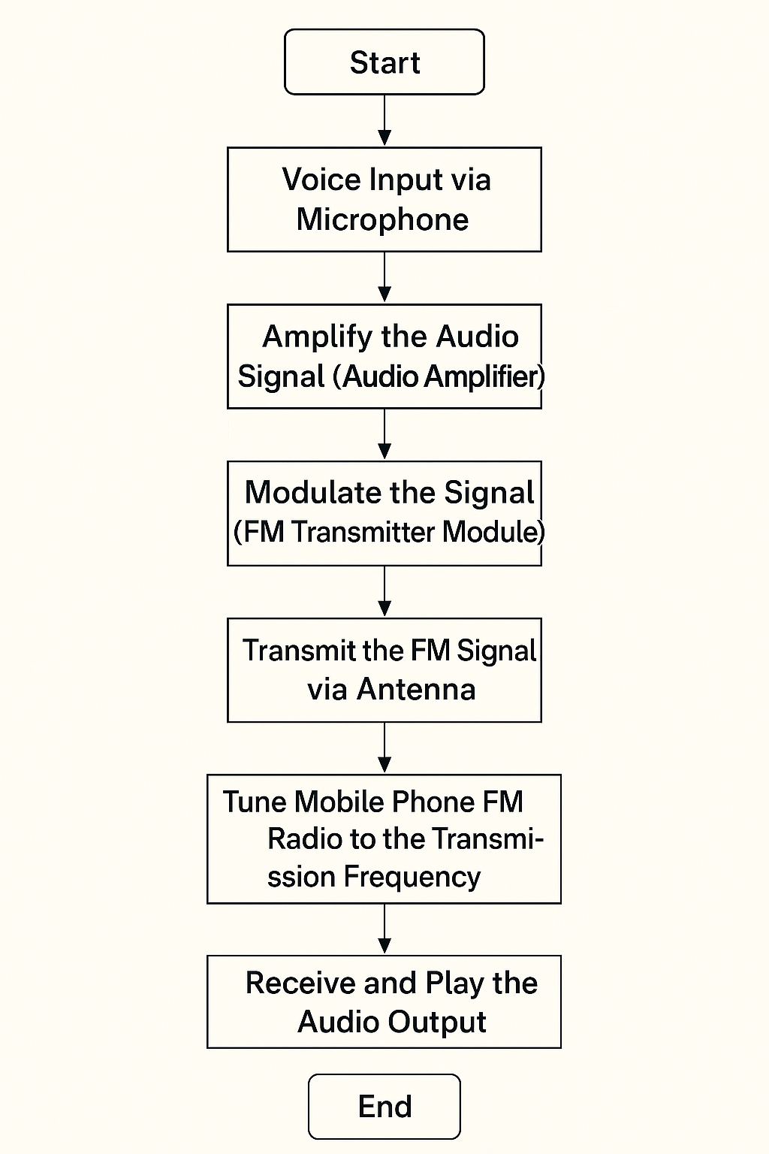
FLOW CHART / IMPLEMENTATION
FIG 2. FLOW CHART

Slide 12
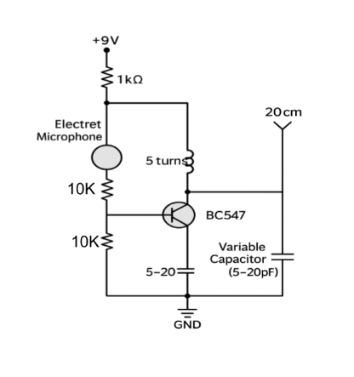
CIRCUIT DIAGRAM
Fig.3.Circuit diagram

Slide 13
Design Specifications
4.Tank Circuit (LC Circuit)
Inductor: Air-core coil made from 20 cm copper wire
Number of Turns: 5 turns
Coil Diameter: ~5 mm
Capacitor: Variable Capacitor (20 pF)
Resonant Frequency Range: Within FM Band (typically 88 MHz to 108 MHz)
5.Antenna
Type: Single wire antenna
Length: Approximately 20 cm (Copper wire)
Connection: Junction of the inductor and collector
6. Frequency Range
Designed to operate in the FM broadcast band (88 MHz – 108 MHz).
Fine-tuning achievable via the variable capacitor.
7. Modulation Type
Frequency Modulation (FM)
8. Output Range
Expected to cover a distance of 30–100 meters under ideal conditions (depending on environment and antenna).
1. Power Supply
Operating Voltage: +9V DC
Power Consumption: Low (<100 mW)
2. Microphone Section
Type: Electret Condenser Microphone
Biasing Resistor: 1 kΩ (connected between +9V and microphone VCC)
Coupling Resistor: 10 kΩ (between microphone output and transistor base)
3. Transistor Section
Type: NPN (BC547)
Configuration: Common-emitter amplifier
Biasing Resistor: 10 kΩ (between base and ground)
Emitter Connection: Directly connected to ground (no emitter resistor)

Slide 14
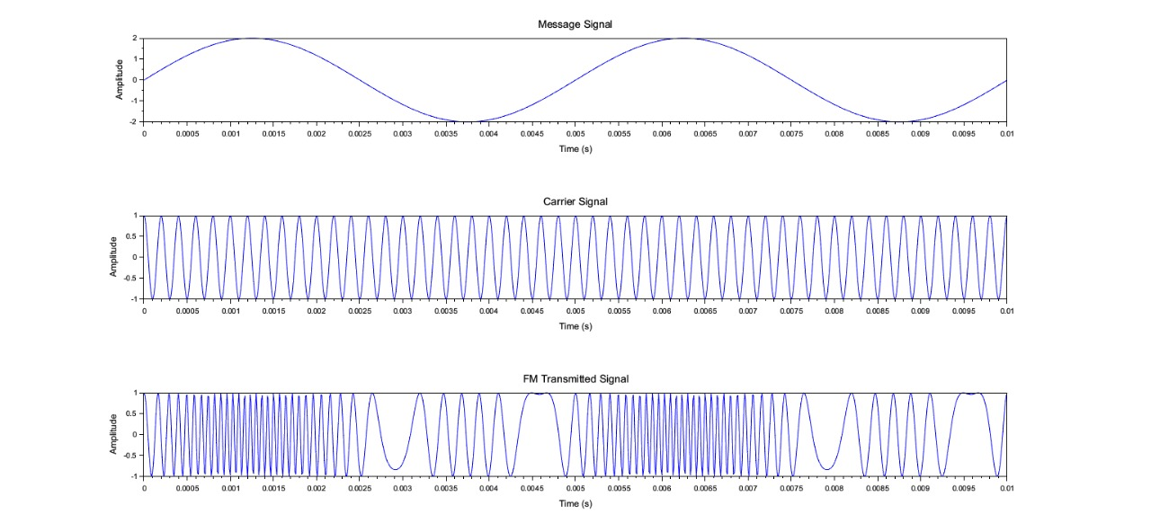
OUTPUT
Fig.4.Output of FM Transmitter

Slide 15
CODE:
fs = 100000; // Sampling frequency (Hz) (higher for better accuracy)
t = 0:1/fs:0.01; // Time vector for 10 ms
Am = 2; // Higher Amplitude of message // Message signal
fm = 200; // Message frequency (Hz)
m_t = Am * sin(2 * %pi * fm * t); // Message signal
Ac = 1; // Amplitude of carrier// Carrier signal
fc = 5000; // Carrier frequency (Hz)
kf = 2 * %pi * 5000; // Higher frequency sensitivity (rad/s/volt) // Modulation index
int_m = cumsum(m_t) / fs; // Numerical integration// Integrate message signal
s_t = Ac * cos(2 * %pi * fc * t + kf * int_m);// FM signal
clf();
subplot(3,1,1);// Plotting
plot(t, m_t);
title('Message Signal');
xlabel('Time (s)');
ylabel('Amplitude');
subplot(3,1,3);
plot(t, s_t);
title('FM Transmitted Signal');
xlabel('Time (s)');
ylabel('Amplitude');

Slide 16
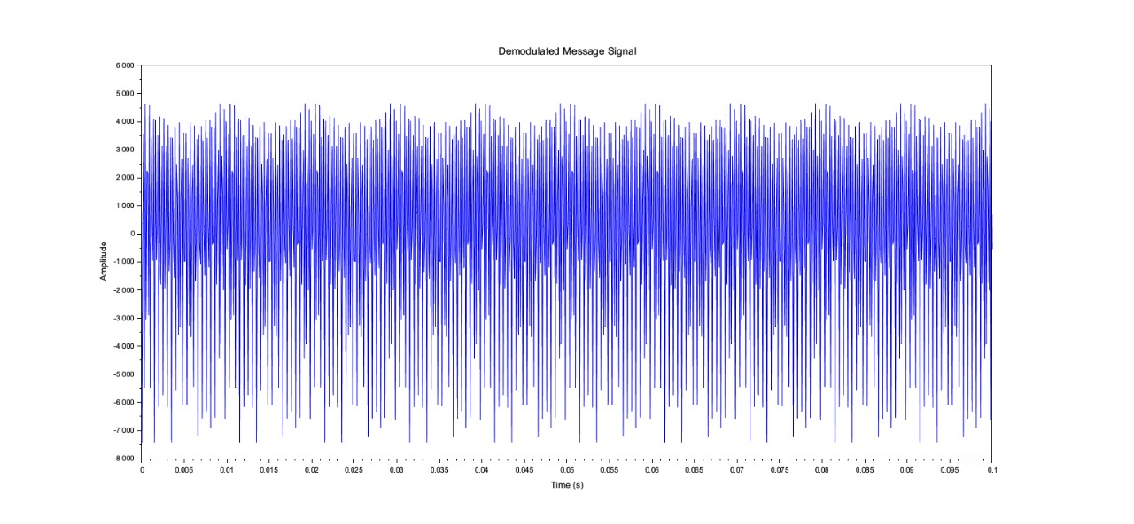
Fig.5. Output for FM Receiver

Slide 17
CODE:
fs = 10000; // Sampling frequency (Hz)
t = 0:1/fs:0.1; // Time vector (0.1 seconds duration)
fc = 2000; // Carrier frequency (Hz)
kf = 2*%pi*75; // Frequency sensitivity (Hz per volt)
Am = 1; // Message signal amplitude
fm = 100; // Message frequency (Hz)
m = Am * cos(2*%pi*fm*t); // Message signal
int_m = cumsum(m)/fs; // Integral of message signal
s_fm = cos(2*%pi*fc*t + kf*int_m); // FM modulated signal
scf(0);// PLOT MESSAGE AND FM SIGNAL
subplot(2,1,1);
plot(t, m);
title('Message Signal m(t)');
xlabel('Time (s)');
ylabel('Amplitude');
subplot(2,1,2);
s_diff = [0 diff(s_fm)*fs]; // Differentiate FM signal
m_rec = m_rec - mean(m_rec); // Remove DC component
scf(1);// PLOT DEMODULATED SIGNAL
plot(t, m_rec);
title('Demodulated Message Signal');
xlabel('Time (s)');
ylabel('Amplitude’)

Slide 18
APPLICATIONS
Educational Institutions:
Used in schools and colleges to make announcements across multiple classrooms and blocks without the need for extensive wiring.
Office Buildings and Industries:
Facilitates internal communication across departments or workstations, especially in large areas or multi-story buildings.
Emergency Notification Systems:
Useful for broadcasting emergency alerts such as fire alarms, evacuation notices, or important safety messages.
Public Transport Terminals:
Deployed in railway stations, bus terminals, and airports for schedule announcements and passenger information.

Slide 19
PRECAUTIONS:
Here are some precautions for our project “FM Wireless Public Announcement System” :
1. Ensure proper power supply to avoid signal loss or system failure.
2. Check antenna placement for optimal signal reception and minimal interference.
3. Keep the transmission power within legal limits to comply with FM broadcasting regulations.
4. Protect the circuit components from overheating by ensuring proper ventilation.
5. Test system performance regularly to ensure consistent audio quality and range.

Slide 20
CONCLUSION
The FM Wireless Public Announcement System was successfully designed using a microphone and a basic FM transmitter without relying on any external FM receiver modules.
The transmitted audio signal could be clearly received on standard FM radios or smartphones tuned to the designated frequency.
The system demonstrated a simple, low-cost, and effective method for wirelessly transmitting voice over short distances for public communication.
Future improvements could include enhancing the transmission range, reducing noise, and adding features like multi-channel transmission for broader applications.

Slide 21
FUTURE WORK
Multi-frequency support: Adding support for multiple FM channels for different zones or departments.
Digital display: Integrating an LCD or OLED screen to display the current frequency or status.
Audio recording module: Implementing a feature to record and replay announcements automatically.
Battery-powered operation: Making the system fully portable by integrating rechargeable battery support.
Remote frequency control: Using wireless modules like Bluetooth or Wi-Fi to change the frequency remotely via a smartphone app.
Integration with sensors: Triggering emergency announcements based on sensor inputs (e.g., fire or motion detection).

Slide 22
BUDGET DETAILS
COMPONENT | QUANTITY | PRICE
Electret Condenser Microphone | 1 | ₹20
NPN Transistor(BC547) | 1 | ₹20
Variable Capacitor (5–20 pF) | 1 | ₹30
Copper Wire for Inductor | 20 cm | ₹5
Resistors (1kΩ, 10kΩ, 100Ω, etc) | 5 | ₹15
9V Battery | 1 | ₹20
9V Battery Clip | 1 | ₹5
Antenna (copper wire) | 20cm | ₹5
Breadboard | 1 | ₹65
Jumper Wires | 10 | ₹20
Total Cost: ₹205

Slide 23
SDG’s Involved
The "FM based Wireless Public Announcement System" project is most closely related to the following United Nations Sustainable Development Goals (SDGs):
SDG 9: Industry, Innovation, and Infrastructure
How it's related:
Our project promotes the development of innovative communication infrastructure, especially for public information dissemination in places with limited access to modern PA systems.
It's a low-cost, scalable, and wireless solution, which aligns with improving infrastructure and fostering innovation.
SDG 11: Sustainable Cities and Communities
How it's related:
This system can be used for public safety alerts, community announcements, and emergency broadcasting, especially in urban and rural areas where wired systems are not feasible.
Supports the goal of making cities inclusive, safe, resilient, and sustainable by ensuring timely information reaches everyone.

Slide 24

VIDEO DEMONSTRATION

Slide 25
REFERENCES
1. H. Ma, Y. Fang, P. Chen, and Y. Li, "Reconfigurable Intelligent Surface-aided M-ary FM-DCSK System: A New Design for Noncoherent Chaos-based Communication," IEEE Transactions on Vehicular Technology, vol. 72, no. 4, pp. 4829–4843, Apr. 2023. [Online]. Available: https://arxiv.org/abs/2206.07997​Google Scholar
2. K. Banerjee, S. Karmakar, A. Chakraborty, M. M. Jha, S. Ghosh, and A. Bose, "Wireless Smart Public Announcement System Using Bluetooth Technology," Advanced Scientific Research, vol. 7, no. 2, pp. 1–8, 2024. [Online]. Available: https://zenodo.org/records/12696932​Zenodo+1Zenodo+1
3. A. Pandey, R. Asim, K. Mengal, M. Varvello, and Y. Zaki, "SONIC: Connect the Unconnected via FM Radio & SMS," in Proceedings of the 20th International Conference on Emerging Networking EXperiments (CoNEXT '24), Los Angeles, CA, USA, Dec. 2024, pp. 41–47. [Online]. Available: https://arxiv.org/abs/2407.01738​NYU Scholars+1Google Scholar+1

